Slide 1

Time Series Forecasting of Air Quality Index in Seattle
John Foster

Slide 2

Agenda
1) Introduction
2) Purpose and Hypothesis
3) Analysis Summary
4) Findings
5) Limitations
6) Recommendations
7) Expected Benefits

Slide 3




Introduction
Background
Experience with Environmental Data
Choice of Analysis

Slide 4

Purpose and Hypothesis
Forecasting Daily AQI in Seattle
Hypotheses
Practical Applications

Slide 5
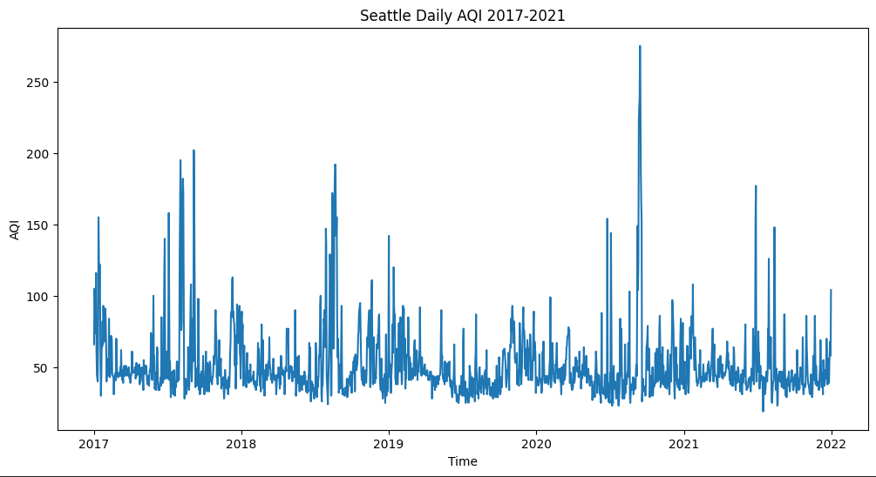
Analysis Summary
Data Sourcing
AQI Datasets
(EPA, 2017-2021)
Data Processing
Exploring the Data
Seasonality
Model Identification
Grid Search
Model Evaluation
“MAPE”
(Lewis, 1982)

Slide 6
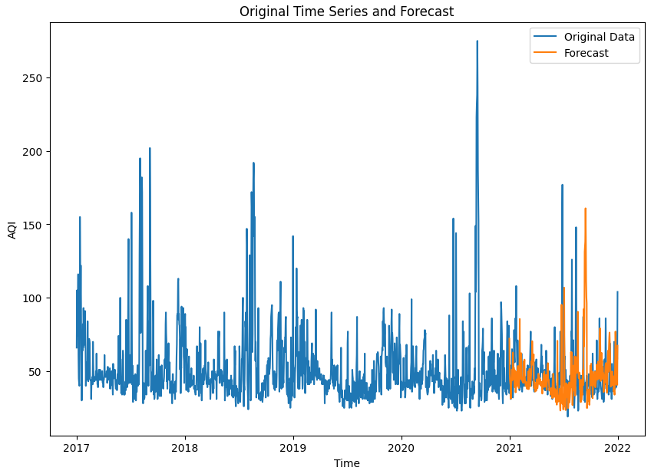
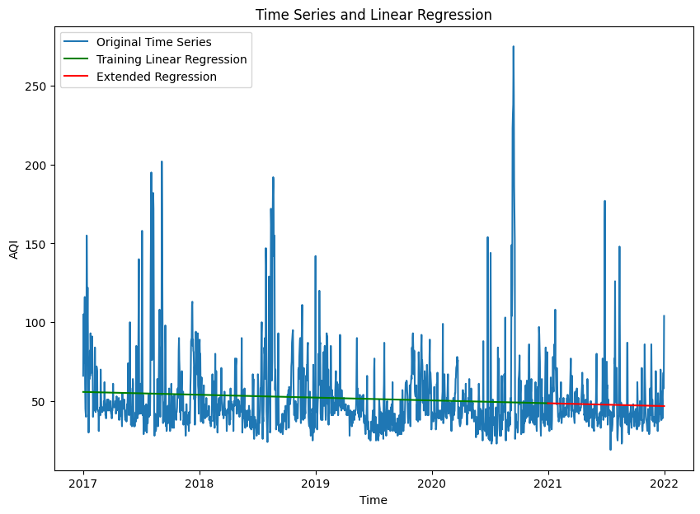
Analysis Findings
Final Model Performance
MAPE: >30%
Compared to Linear Regression:
MAPE: >22%

Slide 7
Limitations
“Noise” in a Time Series Model
Technical Limitations
What is “Noise?”
How does noise affect forecasting accuracy?
What is AQI?
Contributing factors
Unpredictability
Is there a better way?
Software Choices for Time Series Models
Statsmodels
Costly Hardware Demands
Expensive Workarounds
Prophet
Modern Implementations
Pedigreed Developers (META)

Slide 8



Recommendations
Reducing Data Noise
Smoothing
Retains Forecasting Potential
Advanced Metrics
Re-Expressing the Data
Simplicity of Categorical Data
Ease of Comparison Between Regions
Straightforward Metrics

Slide 9


Expected Benefits
Direct vs. Indirect Benefits
Lessons Learned in Analytics
Limitations of Time Series Forecasting
Characteristics of Raw AQI Data
Software Recommendations

Slide 10

References
US Environmental Protection Agency. (2017-2021). Air Quality System Data Mart [internet database] available via https://www.epa.gov/outdoor-air-quality-data. Accessed July 07, 2023. https://aqs.epa.gov/aqsweb/airdata/download_files.html#AQI.
Lewis, C.D. (1982). Industrial and Business Forecasting Methods. Butterworths Publishing. London.

Slide 11
Thank you!
John Foster
jfos356@wgu.edu

